Slide 1
Requirement Engineering Process
Disclaimer: The contents in this presentation have been taken from multiple sources available at the internet including books, motes, reports, websites and presentations.

Slide 2
Requirement Engineering Process
RE is performed in the beginning of the system development lifecycle. However, in large and complex systems development, developing an accurate set of requirements that would remain stable throughout the development has been realized to be impossible in practice.

Slide 3
Effective software design begins with the establishment of clear, achievable, and unambiguous requirements. — IEEE Computer Society, on Requirements

Slide 4
Requirement Engineering
RE is an incremental and iterative process, performed in parallel with other system development activities such as design, and going into more detail in each iteration. RE activities cover the entire system and software development lifecycle.

Slide 5
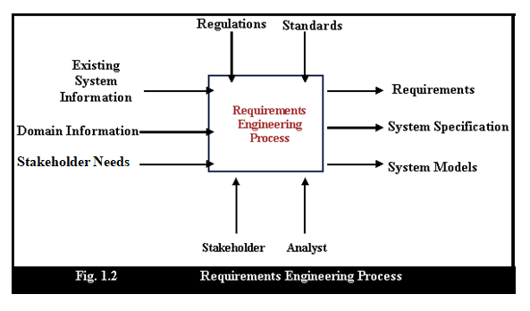

Slide 6
Inputs
Existing System Information
Information about systems that either will be replaced by the proposed system, or which the system must interact with.
Stakeholder Needs
Descriptions of needs stakeholders perceived to have of the suggested system.
Domain Information
General information about the nature of the domain and the types of activities that are covered by the situation being considered.

Slide 7
Controls
Organizational Standards
Standards used in the organization to coordinate system development or maintain quality, etc.
Regulations
External regulations that need to be considered as the problem is considered and the solution evolves.

Slide 8
Mechanisms
STAKEHOLDERS
Are people or organizations affected by the system and who have a direct influence on the requirements? End-users, managers, engineers who develop or maintain related systems, domain experts, union representatives, etc.
May not know what they really want, or may find it difficult to articulate
May make unrealistic demands
Express requirements in their own terms with implicit knowledge of their own work
May be politically motivated
ANALYST
The member of the project team responsible for managing the requirements process (requirements manager).

Slide 9
OUTPUTS
Requirements
The agreed upon functional and non-functional requirements for the system.
System Specification
A more detailed version of the system which may be required in some instances.
System Models
Models, usually in diagrammatic form, which describe the system from the necessary perspectives.

Slide 10
REQUIREMENT ENGINEERING PROCESS
RE processes can be improved by the systematic introduction of good requirements engineering practice. Each improvement cycle identifies good practice guidelines and works to introduce them in an organization.

Slide 11
Spiral Model of Requirements Engineering Process
The spiral model of requirements engineering processes emphasis on continuous reassessment of the elicitation and analysis and combines the iterative and sequential approaches. Here a number of task regions are defined and these task regions are traversed in each iteration. The spiral nature of the model emphasizes that the successive iteration result in a more completely engineered product. As this evolutionary process begins the software engineering team moves around the spiral in a clockwise direction beginning at the center.

Slide 12
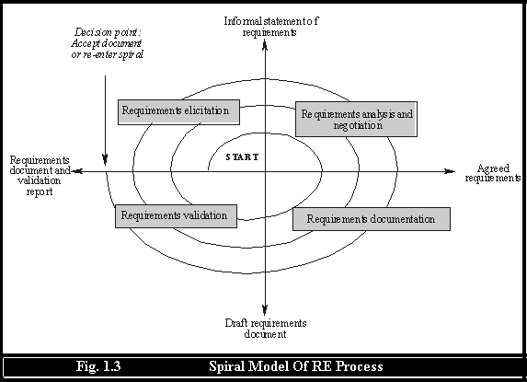

Slide 13
Activities of spiral model of requirements engineering
The spiral model of requirements engineering is divided into four number of framework activities, also called task regions which are:
Requirements Elicitation ------- task required to gather the requirements and after the completion of this task region we get the informal statements of the requirements.
Analysis and negotiation -------- task required to analyzed and model the gathered requirements. Analysis categorizes requirements and organizes them into related subsets, explores each requirement in relationship to others and ranks the requirements based on the needs of the customers / users. At the end of this task region the requirements will be agreed for the further task.
Requirements documentation -------- task required to document the gathered and modeled requirements at the end of this task we get the software requirements specification (SRS).

Slide 14
Requirements validation -------- task required to examine the specification to ensure that all system requirements have been stated unambiguously. Or simple the task required to validate the requirements. At the end of this task region we will get the final requirements document and validation report.
Using the spiral model software is developed in a series of incremental releases. During early iterations the incremental release might be a paper model or prototype. During later iterations increasingly more complete versions of the engineered system are produced.

Slide 15
Importance Of Requirements Engineering
Requirements form the backbone of any successful project, setting the scope for all subsequent work and providing the measure of success or failure. User requirements define stakeholders' needs whilst the system requirements define the functional and non-functional aspects of the system that will realize this need. If these requirements are wrong or misinterpreted there will be confusion, the product will not meet the customers' expectations and the increasing costs could result in the project failing. With 70% of project costs committed before full scale development starts =, it is easy to see why the costs of correcting mistakes after production can be 100 times the cost of getting the requirements right.

Slide 16
What if wrong requirements ?
Suppose we have gathered the wrong requirements now what happens if we did that ??
The system may be delivered late and cost more than originally expected.
The customer and end-users are not satisfied with the system. They may not use its facilities or may even decide to scrap it altogether.
The system may be unreliable in use with regular system errors and crashes disrupting normal operation.

Slide 18
If the system continues in use, the costs of maintaining and evolving the system are very high.
So to gather the right requirements from the customer and to ignore the above losses there will be need of requirements engineering process which actually defines the appropriate way of gathering the requirements to write the specifications.
As we know that the requirements engineering is the systematic process of developing the right requirements. Whose importance can also be determine by answering the following questions
How can the process be systematic when there are many unknown factors at the beginning of the process?
How can we take a step-by-step approach when we don’t know how many steps will be needed or when it is unclear that the end is reached?

Slide 19
Feasibility Study
Feasibility is defined as the practical extent to which a project can be performed successfully. To evaluate feasibility, a feasibility study is performed, which determines whether the solution considered to accomplish the requirements is practical and workable in the software. Information such as resource availability, cost estimation for software development, benefits of the software to the organization after it is developed and cost to be incurred on its maintenance are considered during the feasibility study. The objective of the feasibility study is to establish the reasons for developing the software that is acceptable to users, adaptable to change and conformable to established standards.

Slide 20
How do you cancel a project early? The standard means is by conducting a feasibility study early in the project to determine whether the full-scale project is workable. — Steve McConnell, IEEE Software Best Practices Column

